Slide 1

PySpark
Dr.Chandra Sekhar Vorugunti

Slide 2
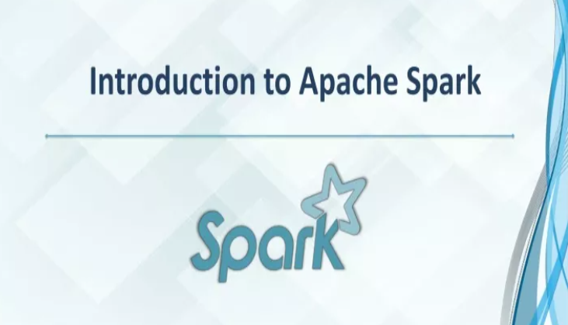

Slide 3


Slide 4
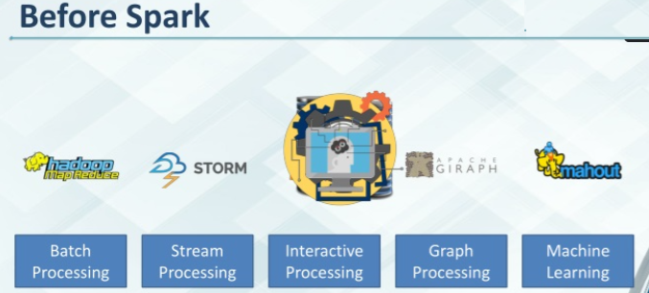

Slide 5
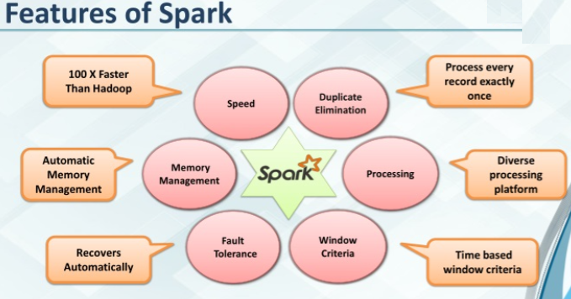

Slide 6
What is Apache Spark?
Apache Spark is an open-source distributed cluster-computing framework introduced by Apache Software Foundation.
It is a general engine for big data analysis, processing and computation. It is built for high speed, ease of use, offers simplicity, stream analysis and run virtually anywhere.
It can analyze data in real-time. It provides fast computation over the big data.
The fast computation means that it's faster than previous approaches to work with Big Data such as MapReduce.
The main feature of Apache Spark is its in-memory cluster computing that enhances the processing speed of an application.
It can be used for multiple things like running distributed SQL, creating data pipelines, ingesting data into a database, running Machine Learning algorithms, working with graphs or data streams, and many more.

Slide 7
What is PySpark
Spark is an open-source, cluster computing system which is used for big data solution. It is lightning fast technology that is designed for fast computation.
PySpark is the Python API to use Spark.
PySpark is a Python API to support Python with Apache Spark. PySpark provides Py4j library, with the help of this library, Python can be easily integrated with Apache Spark.
PySpark plays an essential role when it needs to work with a vast dataset or analyze them. This feature of PySpark makes it a very demanding tool among data engineers.

Slide 8
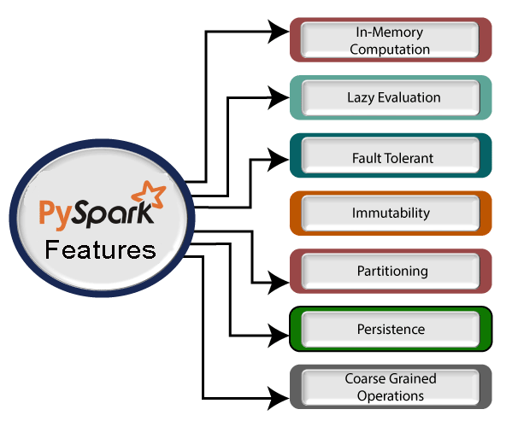

Slide 9
Real-time Computation:
PySpark provides real-time computation on a large amount of data because it focuses on in-memory processing. It shows the low latency.
Support Multiple Language:
PySpark framework is suited with various programming languages like Scala, Java, Python, and R. Its compatibility makes it the preferable frameworks for processing huge datasets.
Caching and disk constancy:
PySpark framework provides powerful caching and good disk constancy.

Slide 10
Swift Processing:
PySpark allows us to achieve a high data processing speed, which is about 100 times faster in memory and 10 times faster on the disk.
Works well with RDD:
Python programming language is dynamically typed, which helps when working with RDD. We will learn more about RDD using Python in the further tutorial.

Slide 11
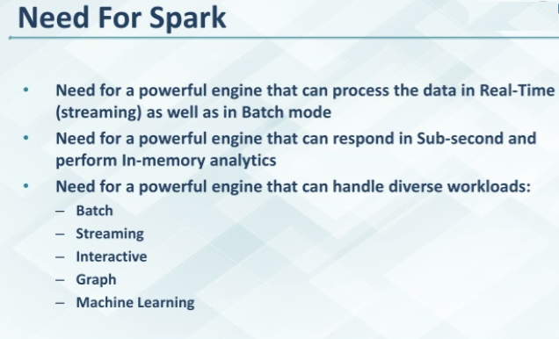

Slide 12
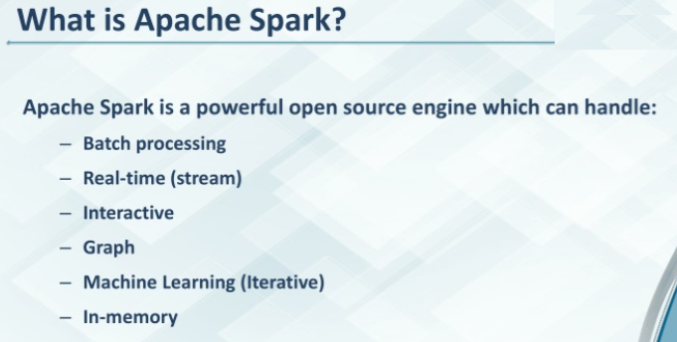

Slide 13
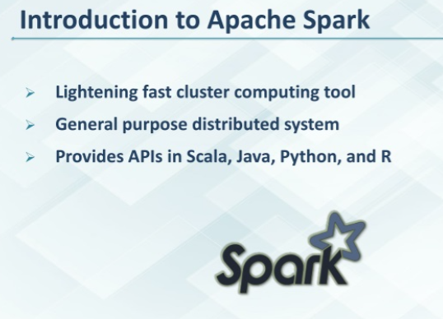

Slide 14
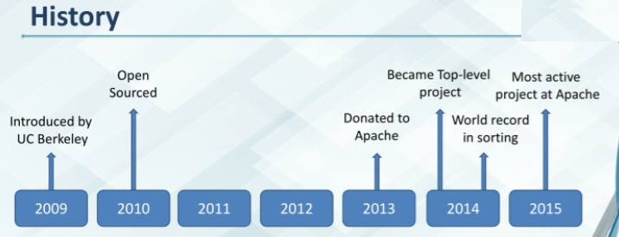

Slide 15
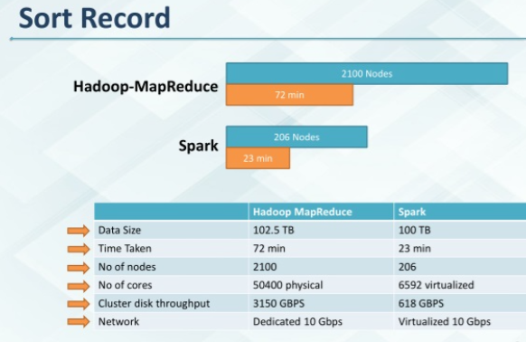

Slide 16
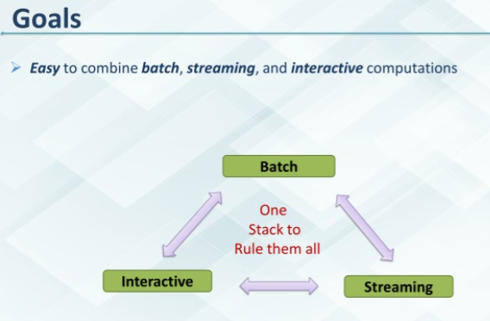

Slide 17
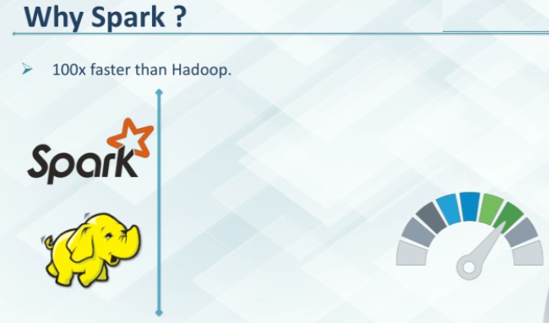

Slide 18
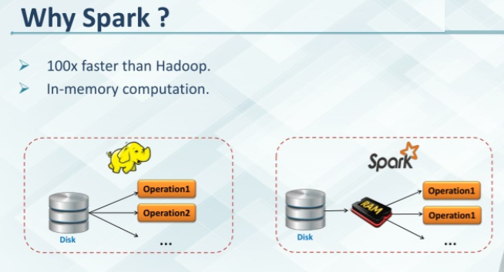

Slide 19
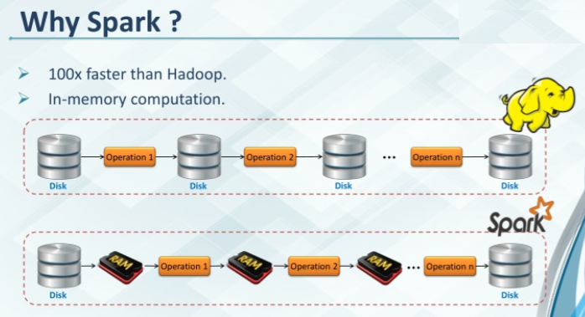

Slide 20
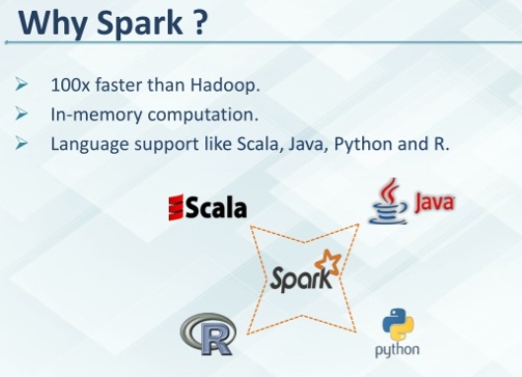

Slide 21
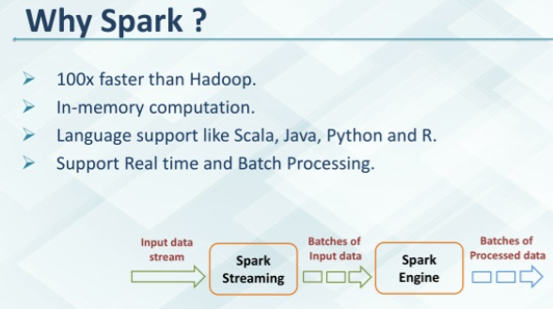

Slide 22
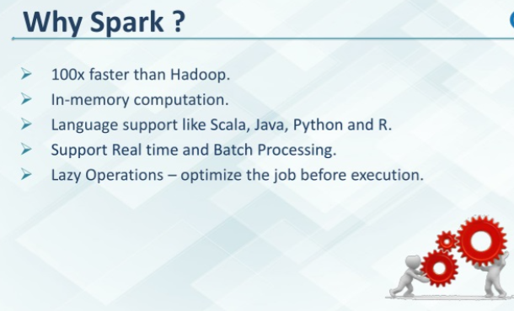

Slide 23
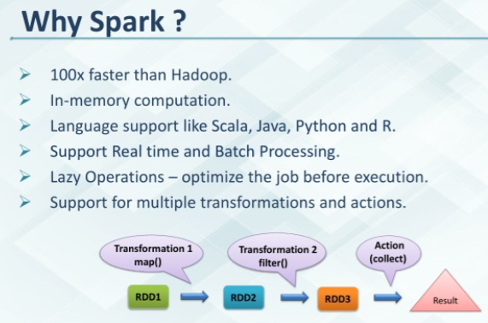

Slide 24
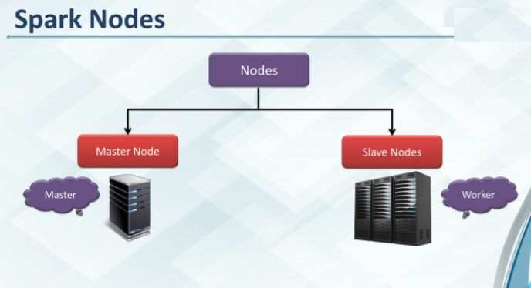

Slide 25
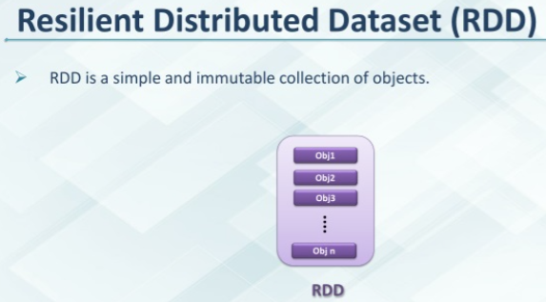

Slide 26
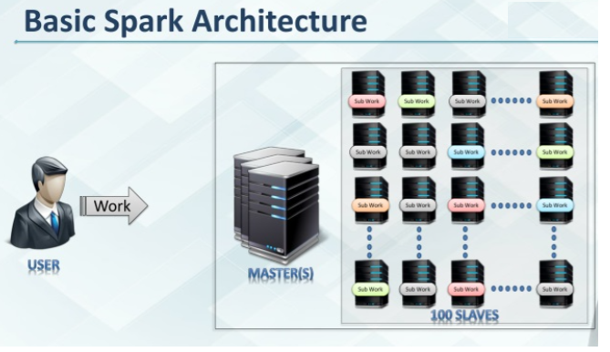

Slide 27
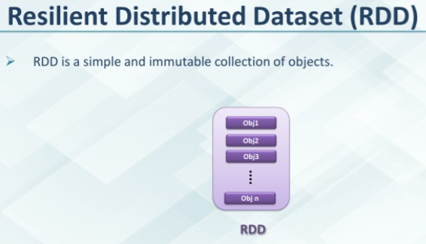

Slide 28
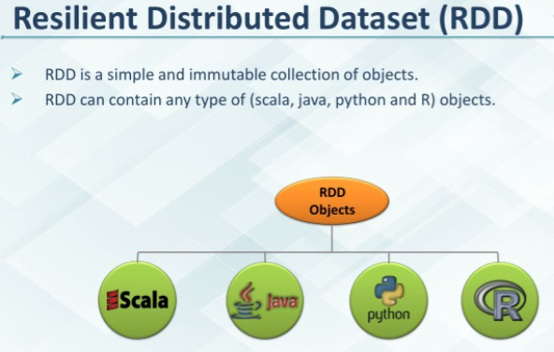

Slide 29
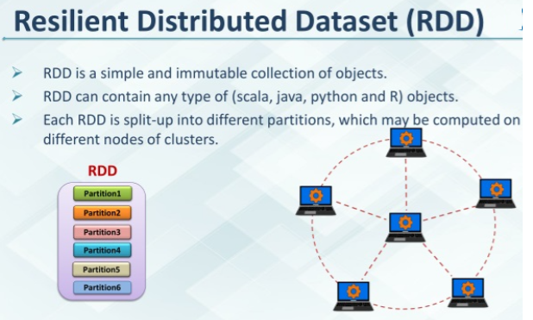

Slide 30
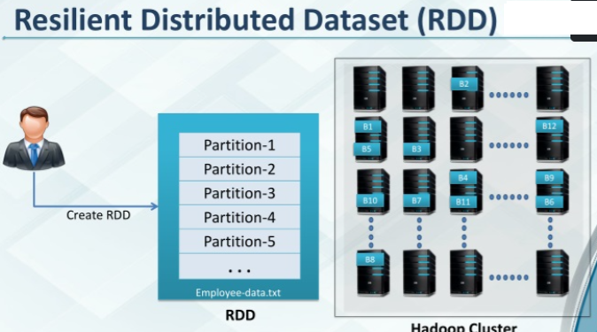

Slide 31
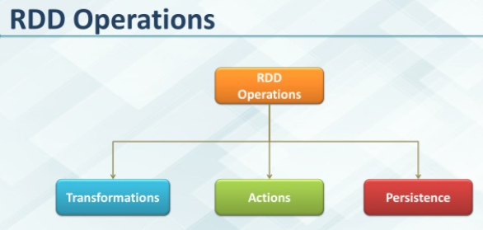

Slide 32
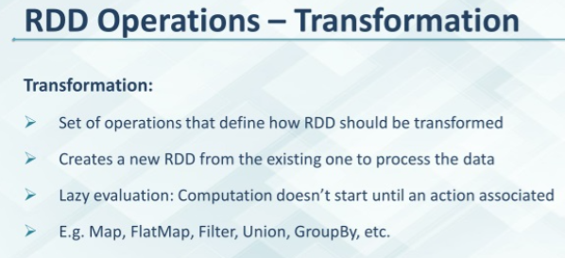
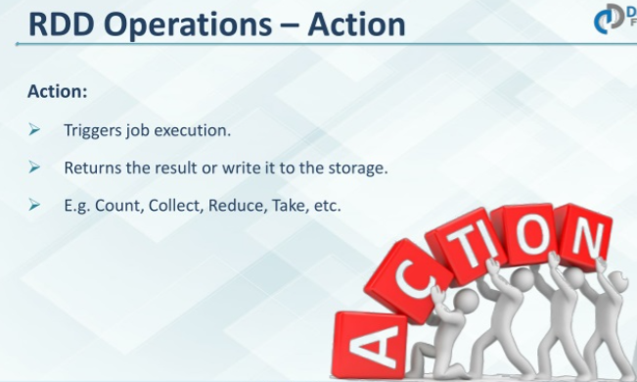

Slide 33
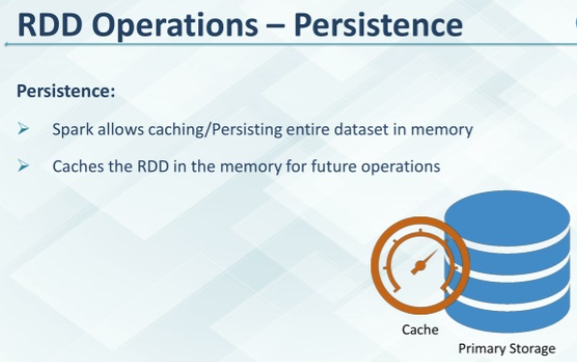

Slide 34
